Slide 1
Introduction to Cyber-Physical Systems(CPS) and Risk Analysis
Author – Praveen Singh
Referenced to the Research Paper submitted

Slide 2
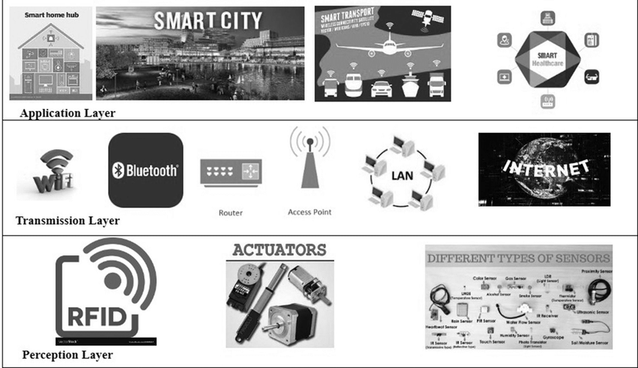
CPS Layered Structure
Reference : https://www.ncbi.nlm.nih.gov/pmc/articles/PMC7340599/

Slide 3
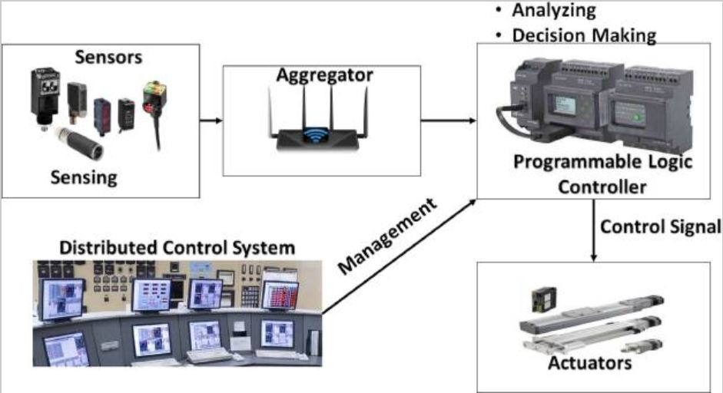
How different layers are connected?
Reference : https://www.ncbi.nlm.nih.gov/pmc/articles/PMC7340599/

Slide 4
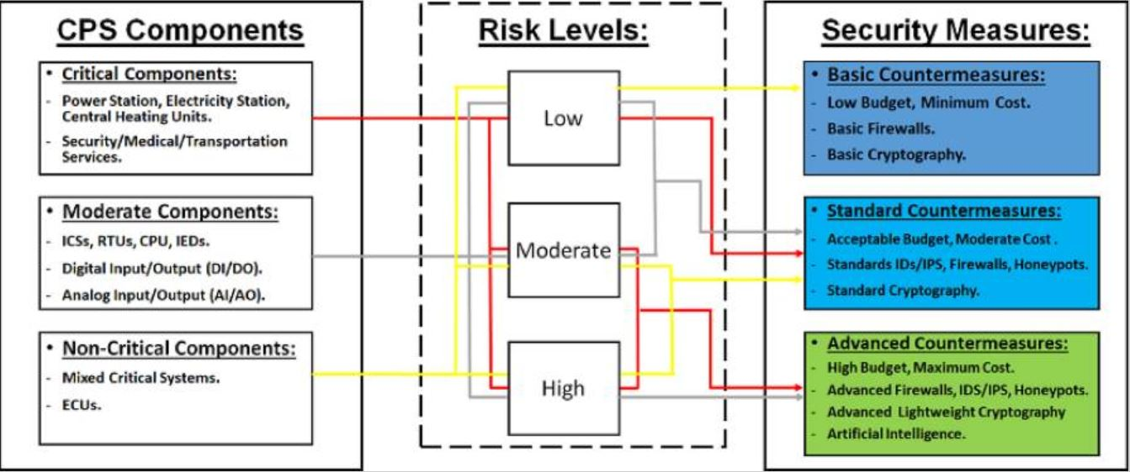
Level of Risks involved with CPSs
Reference : https://www.ncbi.nlm.nih.gov/pmc/articles/PMC7340599/

Slide 5
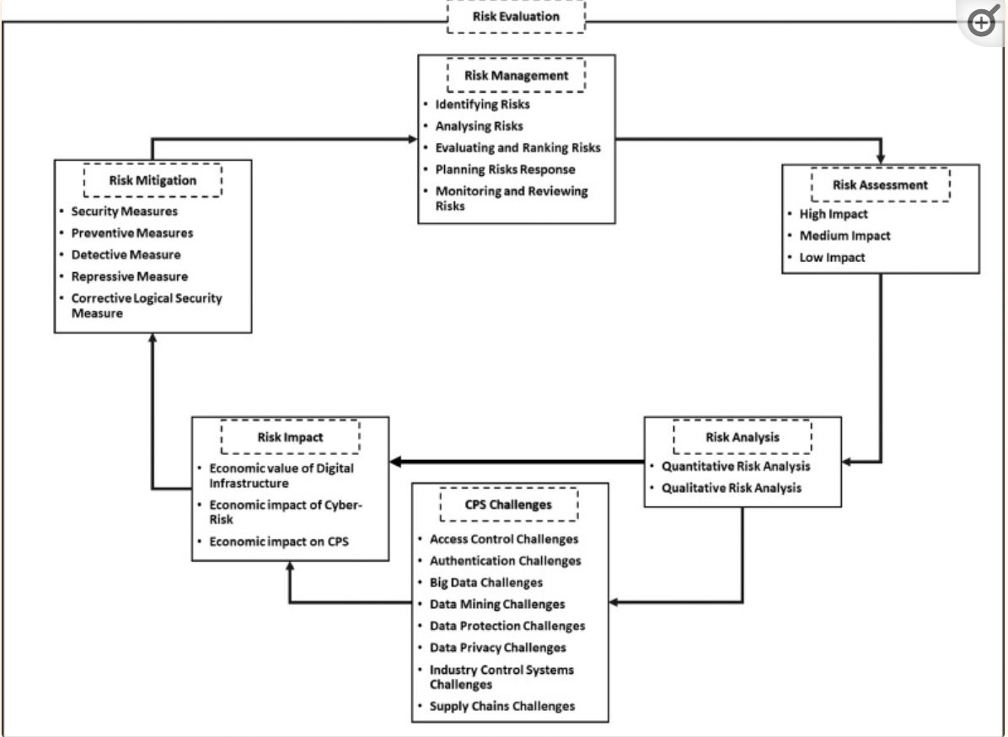
Risk Mitigation steps in case of CPS attack
Reference : https://www.ncbi.nlm.nih.gov/pmc/articles/PMC7340599/

Slide 6
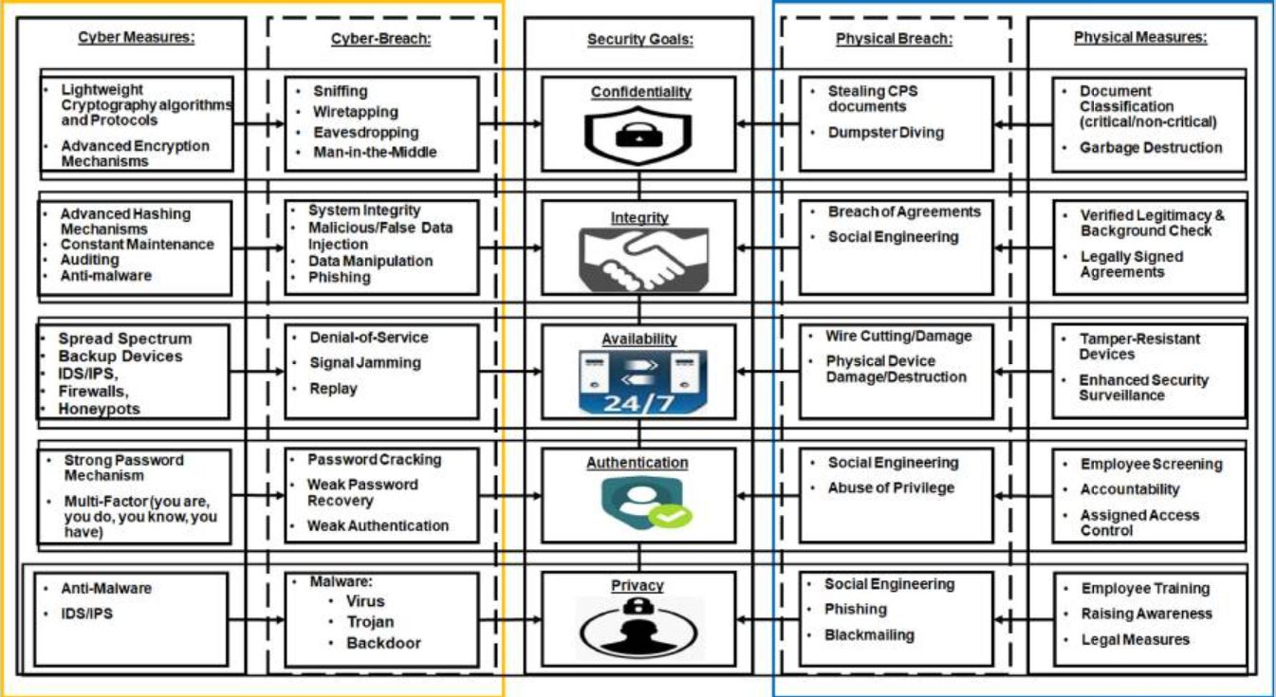
Securing CPS
Reference : https://www.ncbi.nlm.nih.gov/pmc/articles/PMC7340599/

Slide 7
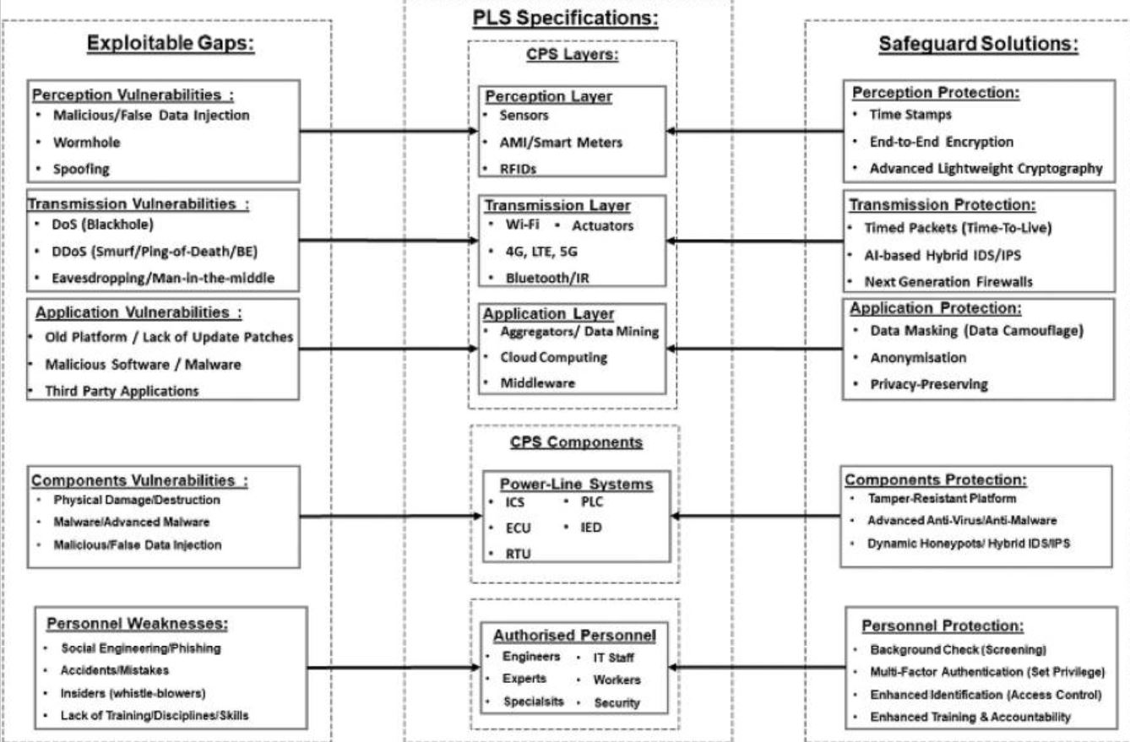
Exploitable Gaps and Solutions for Safeguarding the CPS layers
Reference : https://www.ncbi.nlm.nih.gov/pmc/articles/PMC7340599/

